Slide 1
Web Game
Weeks 39-40-41

Slide 2
About Game
Game should have the four views (pages):
- Main page (home view)
- Start game (game view)
- Game Info (info view)
- Records (records view)

Slide 3
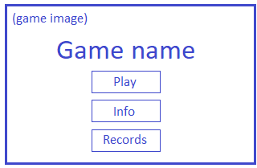
Home View

Slide 4
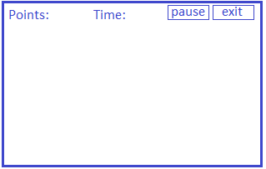
Game View

Slide 5
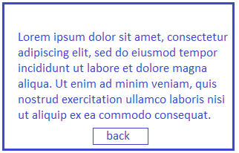
Info View

Slide 6
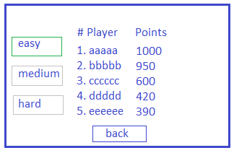
Records View

Slide 7
Views description
MAIN VIEW:
Main page can redirect to "Start Game", "Game Info" and "Records"
START GAME VIEW:
Start Game - prompts for player name and difficulty level
Buttons:
Exit to exit the game
Pause/Play to start or stop the game
GAME INFO VIEW:
Game Info - shows the description what game is about
RECORDS VIEW:
Records - shows all the results from previous games per difficulty level

Slide 8
Database - Model will be created accordingly
Table names and columns:
Players:
Id (PK)
Name
Records:
Id (PK)
PlayerId (FK)
DifficultyLevelId (FK)
DifficultyLevels:
Id
LevelName
LevelRuleId (FK)
DifficultyLevelRules:
Id (PK)
Name
Speed (faster is more difficult)
Obstacles (more is more difficult)

Slide 9
Additional Class (optional)
We can make a special class that is called Game
That class can have:
RecordId
PlayerId with PlayerName
Difficulty level with difficulty rules
We can use this class to hold data for Game controller to make it cleaner

Slide 10
Controllers
Home
GET() → no reading from model
Game
GET() → read from DB player name and difficulty
POST() → save to DB player name and difficulty with points
Info
GET() → no reading from model
Records
GET() → read from DB difficulty, player name and points

Slide 11
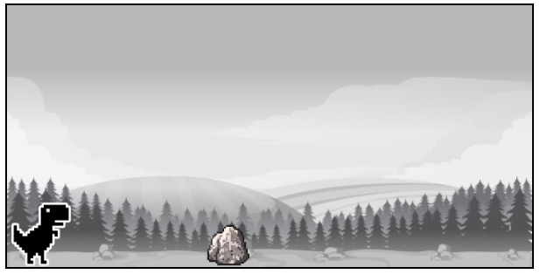
The actual game
We will take the simple game from one developer on GitHub and continue developing it
Code can be downloaded from: https://github.com/kriscfoster/chrome-dino-game

Slide 12
Game – to do
0) Setup the server side + prerequisites for the game
1) Go through all the code downloaded from the example
2) Add buttons, player name and record on the Game view
3) Try to find the changing background for the game – or make it by yourself
4) Try to set different intervals of the rocks moving towards Dino
5) Make Dino look like moving forward and fix the jumping
6) Add some sounds in the background
7) Add additional obstacles in the sky

